Slide 1
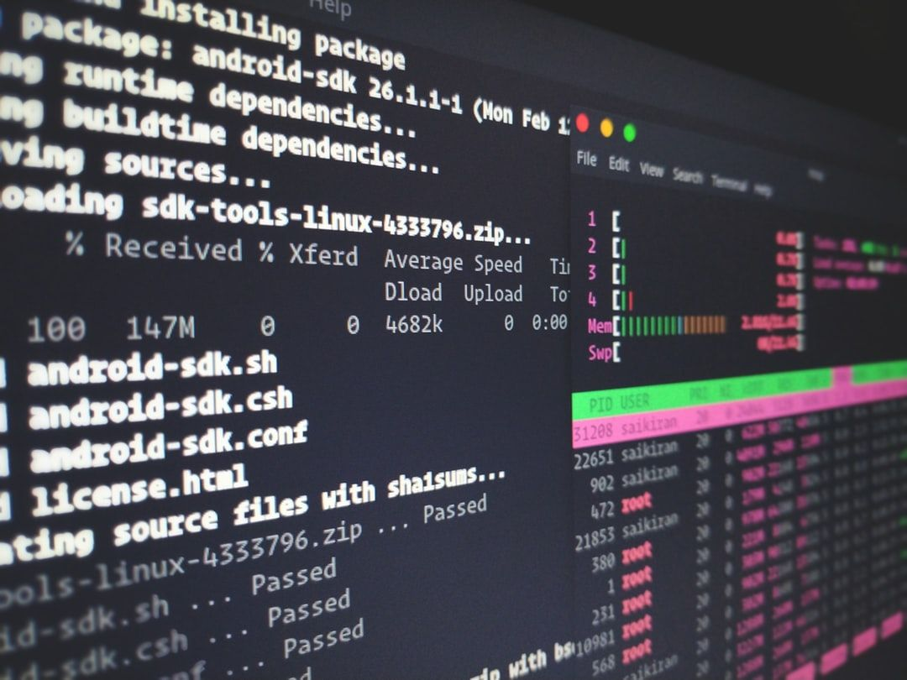

Migrating to Linux: A Proposal for Faster Computing CMIT 291 <2218> Reece Hugo Zunino 11, October 2021

Slide 2


Benefits of using the Linux operating system
Linux is an Open-Source Operating System..
Linux has a variety of Distributions.
Linux is Free to use at no cost to the consumer.
Linux is a secure operating system.
Linux is fast and easy to install.

Slide 3


Go2Linux recommends UBUNTU as the distribution to use for Faster Computing. Ubuntu is a complete Linux operating system, freely available with both community and professional support., has the familiar Windows look and feel and operates well on older hardware. Ubuntu includes thousands of pieces of software, starting with the Linux kernel version 5.4 and GNOME 3.28, and covering every standard desktop application from word processing and spreadsheet applications to internet access applications, web server software, email software, programming languages and tools and of course several games.
Security
UBUNTU is designed to be secure
There is both community and professional support available
Suitability
Support
Fewer system wide permissions then windows
Automatic updates from Canonical
Most popular distribution for beginner Linux users
User friendly
UBUNTU has a windows like feel interface
Is Highly customizable
Has many applications available

Slide 4
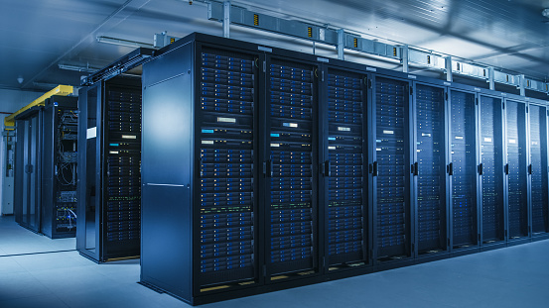

Migration Steps
Check Hardware for compatibility
Discuss software applications
Backup all data on current systems
Train employees on UBUNTU
Install and test on Company Servers
Port over previous data and deploy

Slide 5
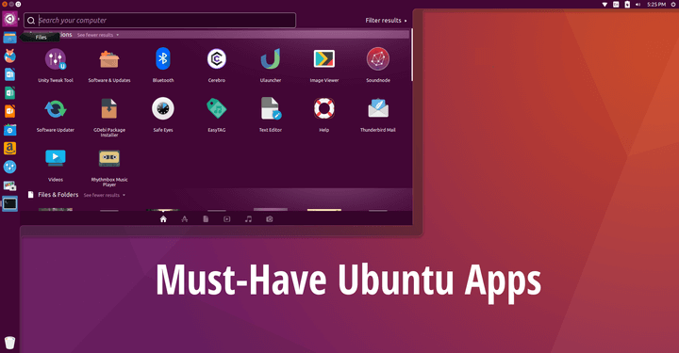
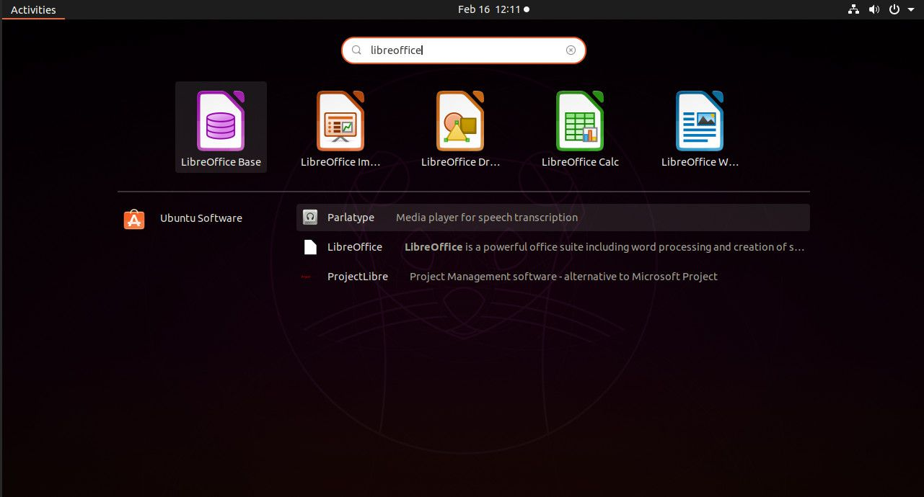
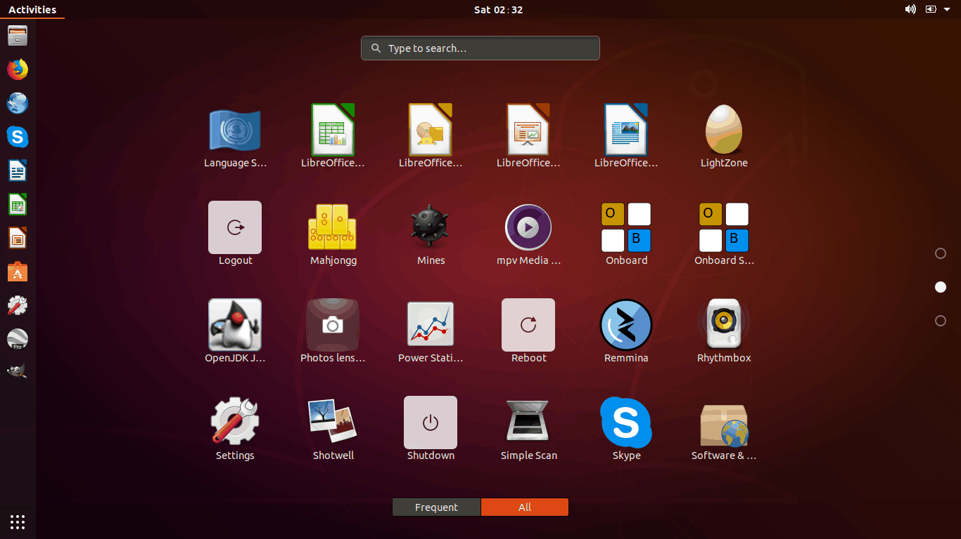

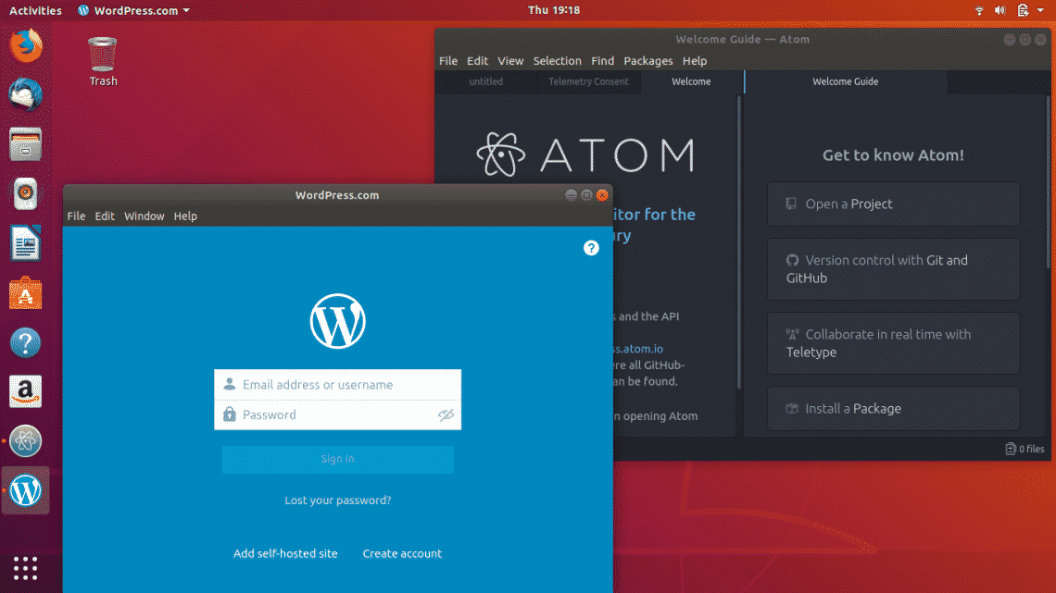
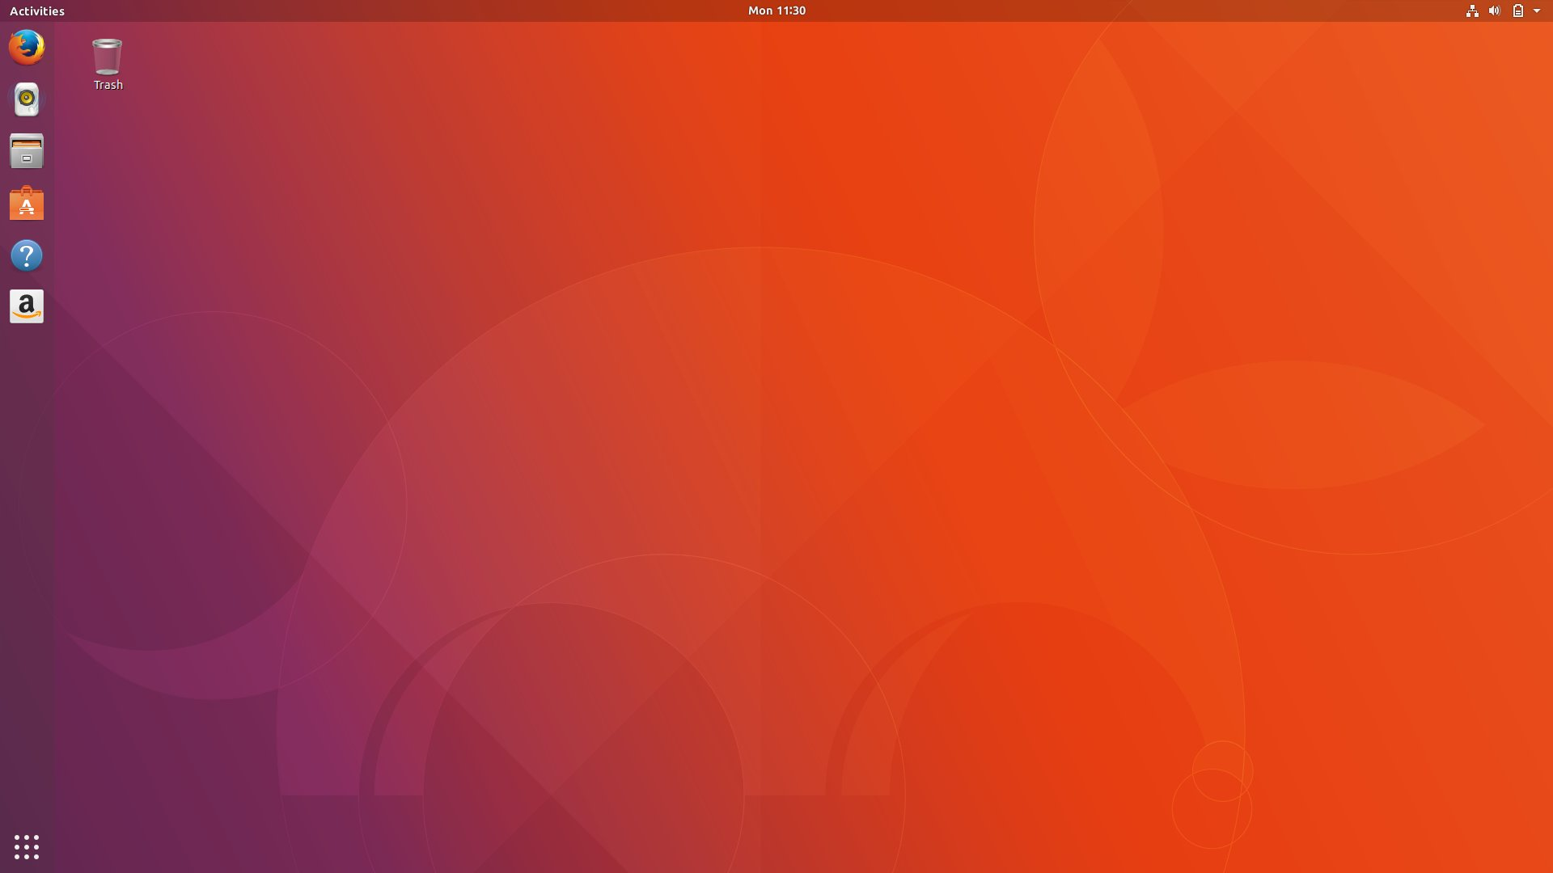
The User Desktop

Slide 6


Tools to provide file sharing, services, and printing
File Sharing
Samba File Server
Services
HTTPD Apache2
Printing
CUPS- Print Server

Slide 7

Summary
No cost to the company for using UBUNTU
Windows like feel user interface
Highly customizable operating system based on the users needs
UBUNTU is a very secure operating system with automatic updates
There are many applications and services available for both the user and the server

Slide 8
References
Canonical. (n.d.). Service - CUPS | Ubuntu. Ubuntu. https://ubuntu.com/server/docs/service-cups
Canonical. (n.d.). Web servers - Apache | Ubuntu. Ubuntu. https://ubuntu.com/server/docs/web-servers-apache
Canonical. (n.d.). File server. Ubuntu. https://ubuntu.com/server/docs/samba-file-server
Linuxhint. (n.d.). 100 best Ubuntu apps. Linux Hint. https://linuxhint.com/100_best_ubuntu_apps/
UBUNTU support. (n.d.). 1.1. What is Ubuntu? Official Ubuntu Documentation. https://help.ubuntu.com/lts/installation-guide/s390x/ch01s01.html
UBUNTU. (n.d.). Security. Ubuntu. https://ubuntu.com/security

